Slide 1
Using Machine Learning for Lie Detection: Classification of Human Visual Morphology
Supervisor: Dr. Mahbub Alam Majumdar
Co-Supervisor: Mr. Moin Mostakim
Team Members:
Monjur Rakib Bhuiyan – 17241022
Anik Zaman – 17241023
Samin Azhan – 14101005

Slide 2
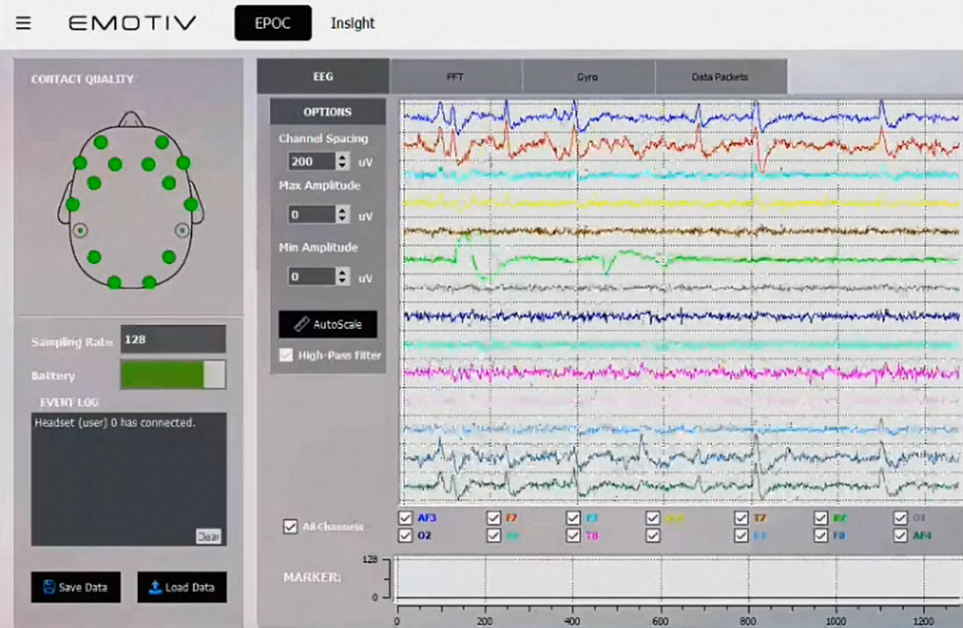

LITERATURE REVIEW
EEG & Machine Learning For Lie Detection
By Jennifer Marsman and her husband Chris Caldwell
Used Emotive Epoc+ to obtain raw EEG (Electroencephalography) data
Used the Two-Class Decision Jungle Algorithm with the help of Azure Machine Learning Studios
Achieved an accuracy of 71.2%
Source: msdn.com

Slide 3
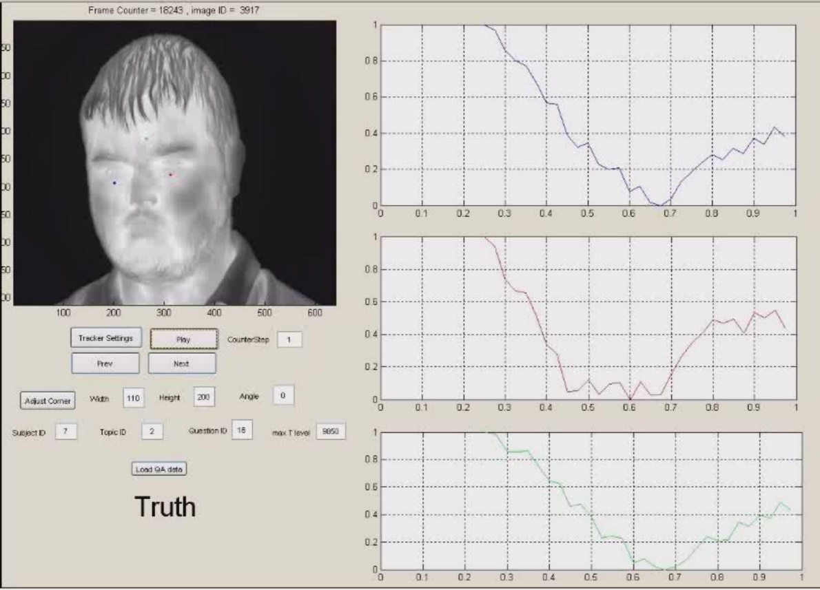
Face Reading Technology For Lie Detection By University Of Bradford
By Hassan Ugail, Moi Hoon Yap and Bashar Rajoub
Used Facial Action Coding System (FACS) to detect Action Units (AU)
Combined with thermal analysis
Accuracy rate of 70%
Source: brad.ac.uk

Slide 4
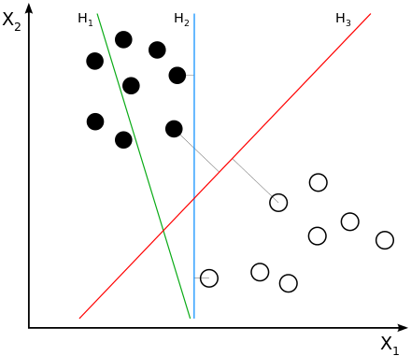
ALGORITHMS
Two-class Support Vector Machine Algorithm
A well-researched class of supervised learning methods
Analyzes input data and recognizes patterns in a multi-dimensional feature space called the hyperplane
Works well when there are more than 100 features
Source: Wikipedia

Slide 5
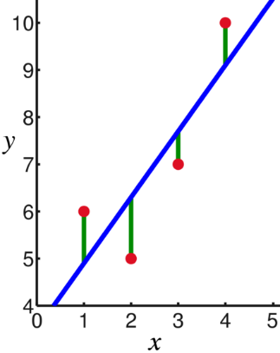
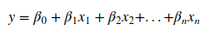
Linear Regression
A statistical method to predict numeric target
Made with an assumption that there is a linear relationship between X and Y
Tries to predict the value of y based on the model coefficients (β) and features (x)
Source: Wikipedia

Slide 6
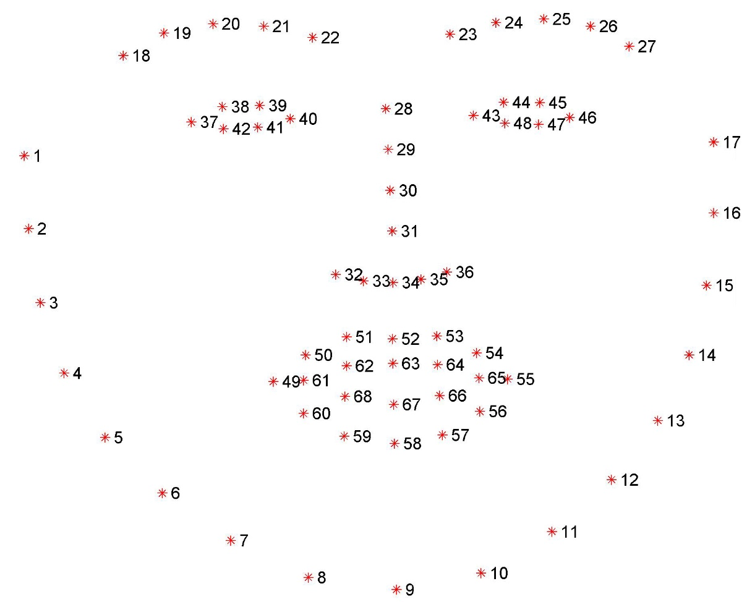
TOOLS
Dlib, Python
A library that provides 68 facial landmarks in real-time and in images
Can localize and represent most noticeable regions of the face such as eyes, nose, eyebrow, mouth and jawline
Possible to calculate the changes of the 68 facial landmarks according to the x-axis and y-axis
Source: pyimagesearch.com

Slide 7

Azure Machine Learning Studio
A collaborative tool that can used to build, test, and deploy predictive analytics solutions on given data
Created by Microsoft and it has perfectly implemented 25 machine learning algorithms
Can be used to create, train and evaluate models with given datasets
Source: msdn.microsoft.com

Slide 8
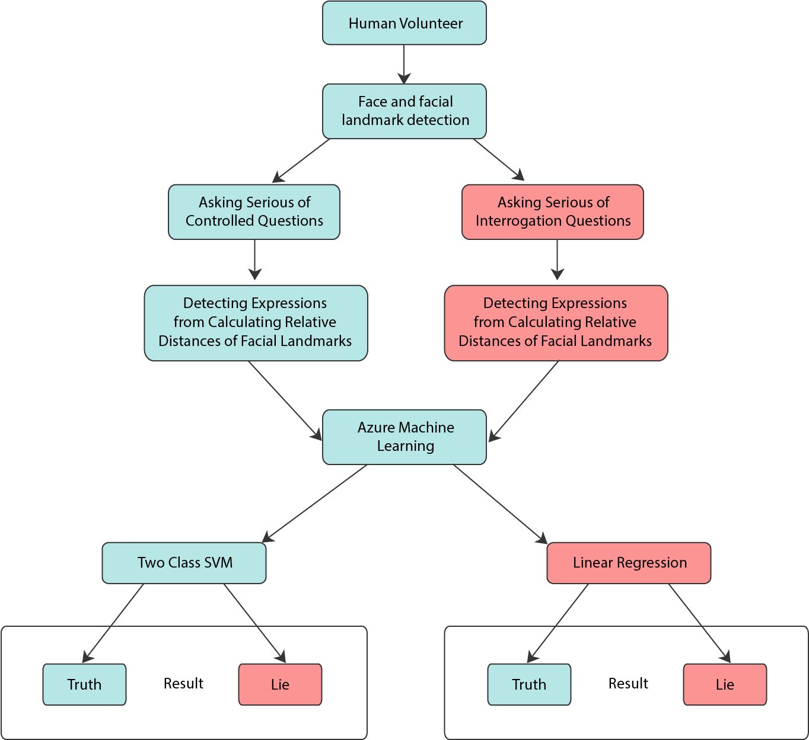
PROPOSED MODEL
Detect face and facial landmarks of human volunteer
Ask a series of controlled questions and record the facial changes
Store data for Azure Machine Learning
Use Two-Class SVM and Linear Regression to train and detect lies

Slide 9

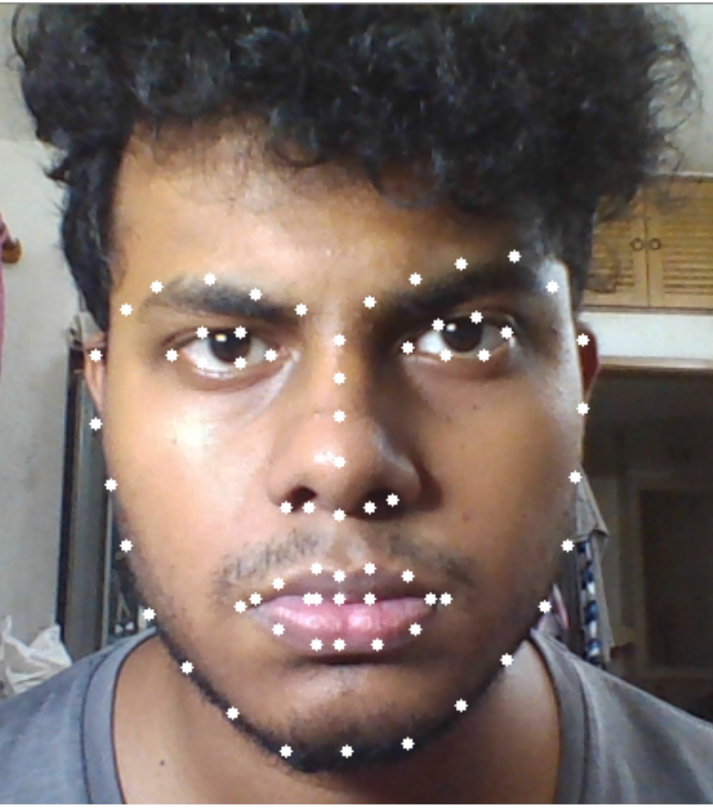
EXPERIMENTAL SETUP
Detecting the Face and Facial Landmarks

Slide 10
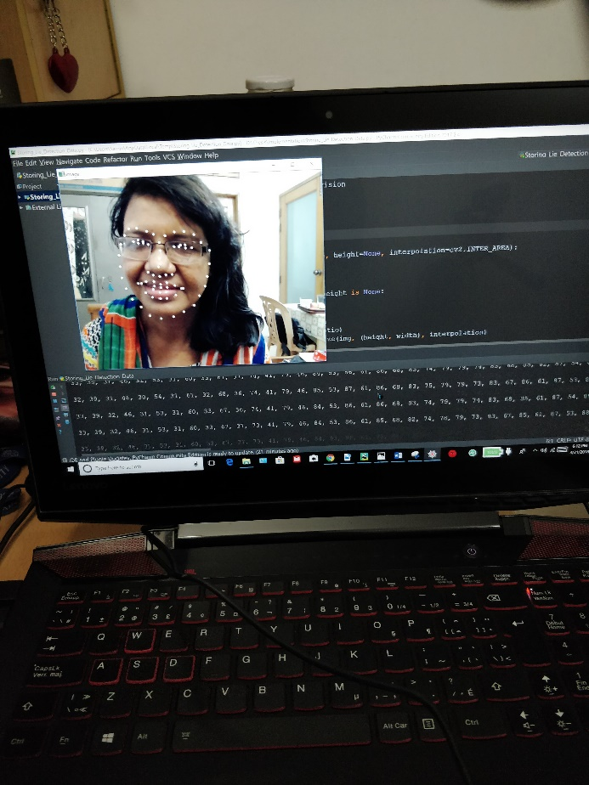
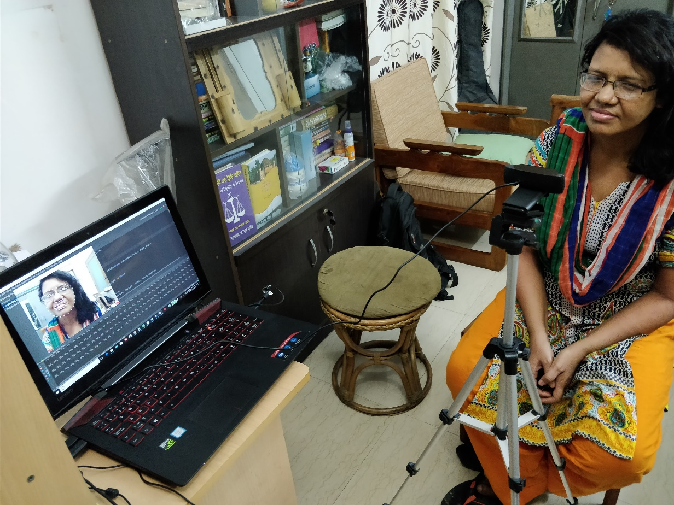
Interviewing
Truth Segment
Lie Segment
Each containing Ten Controlled Yes/No Questions

Slide 11
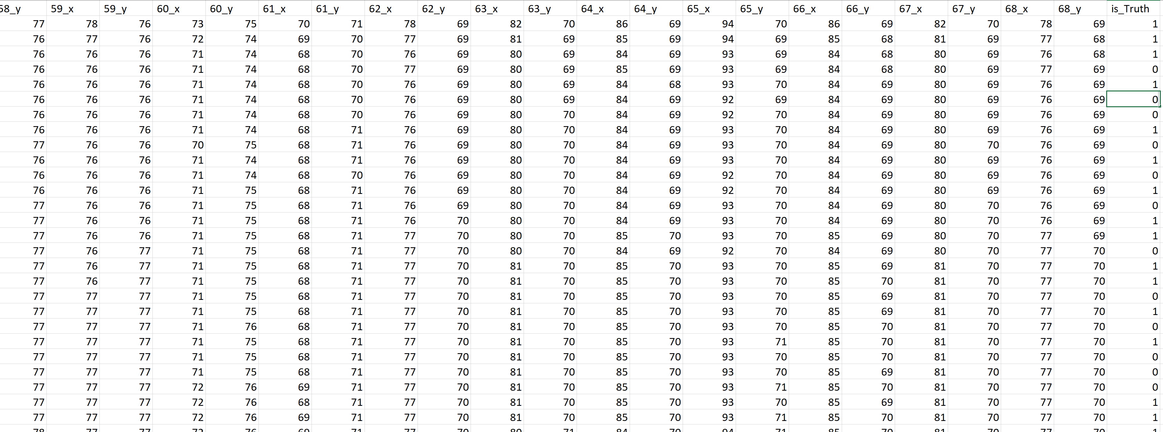
Storing Data For Azure Machine Learning
136 features (1_x, 1_y, 2_x, 2_y… 68_x, 68_y) and 1 label (is_Truth)
38 Volunteers, 5094 rows each containing 137 column

Slide 12
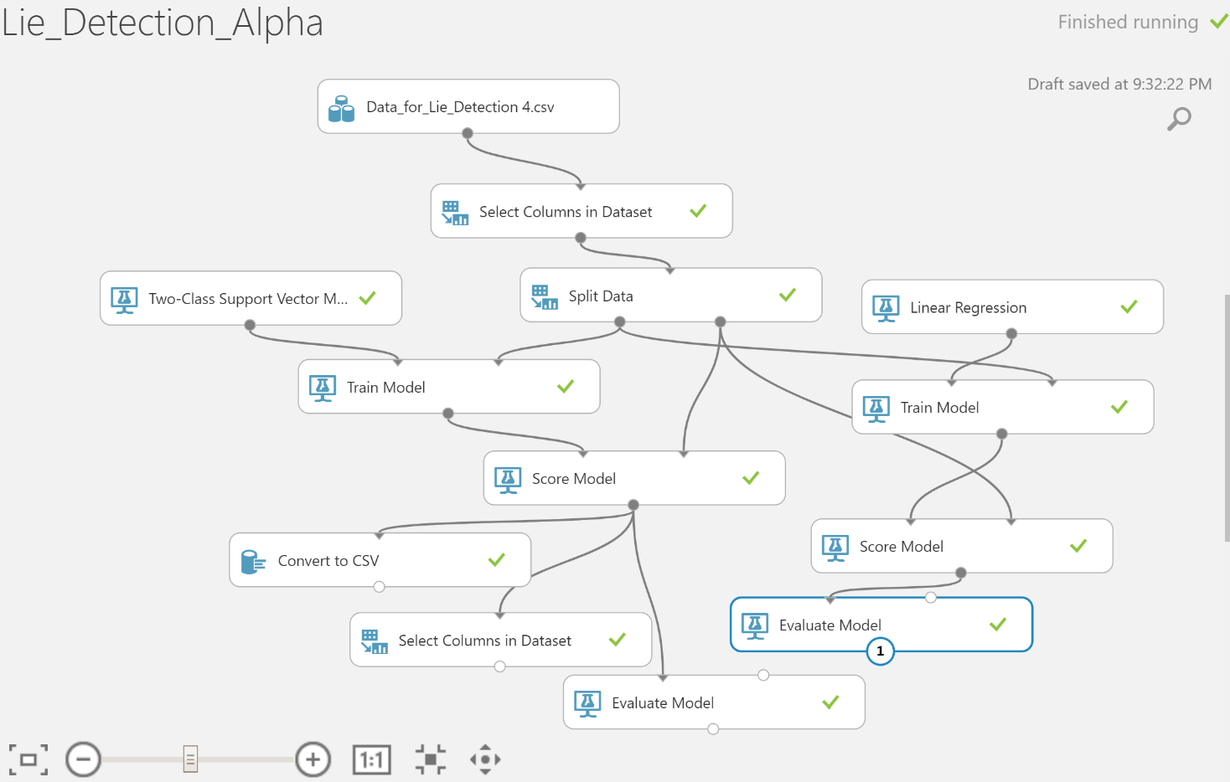
Creating Training Model

Slide 13
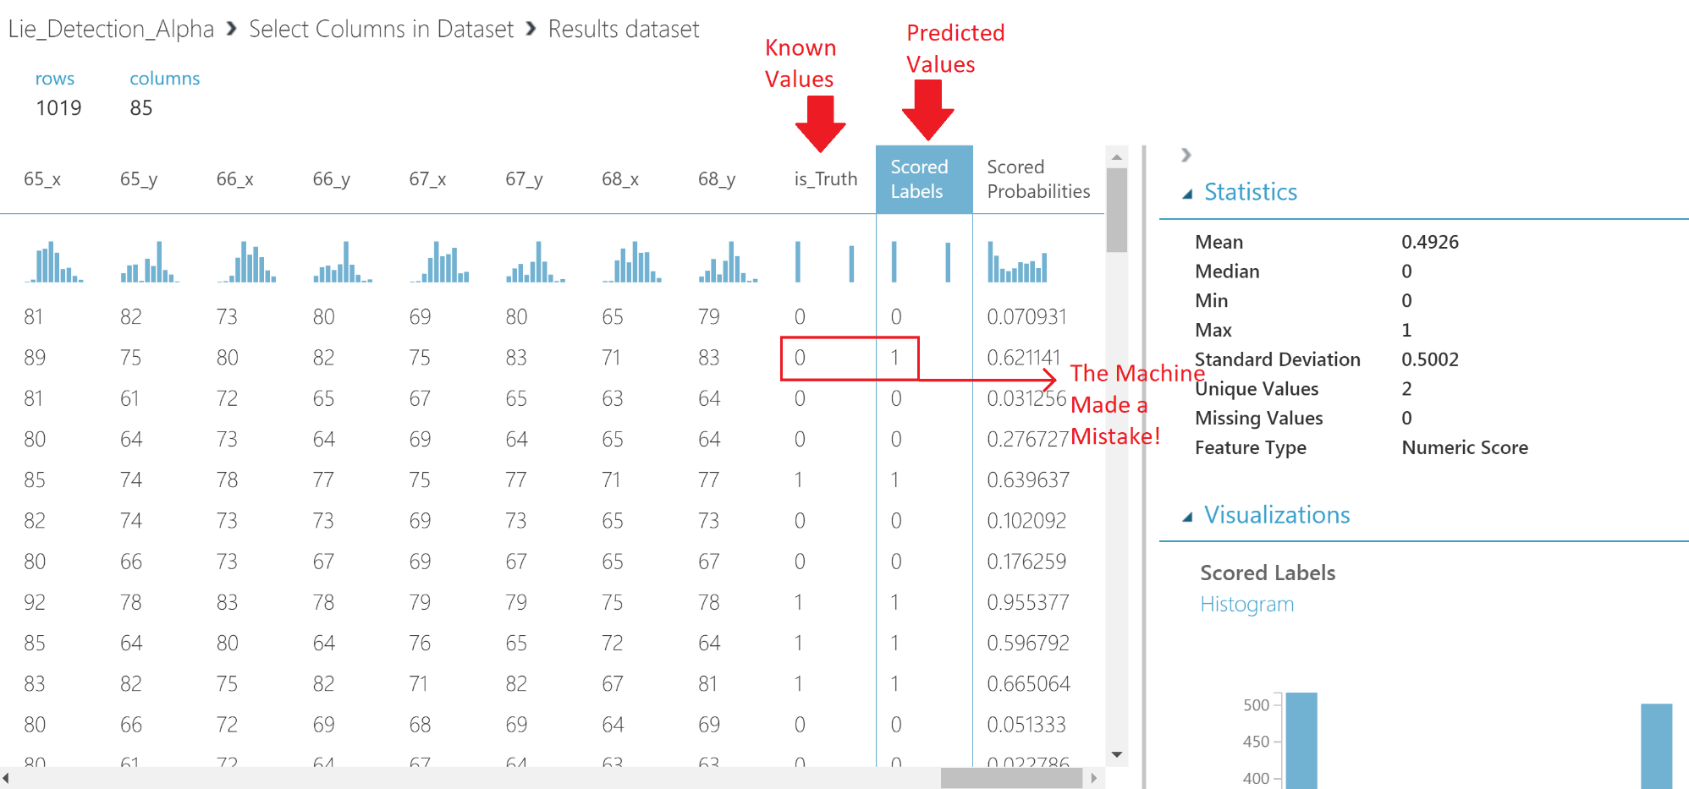
Model’s Predictions

Slide 14
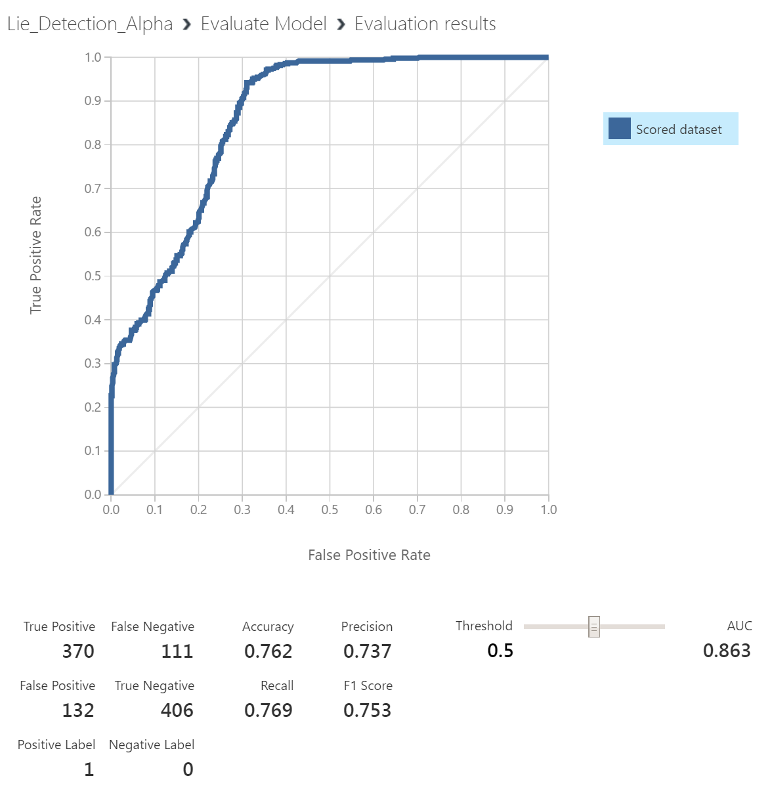
RESULT AND ACCURACY
Linear Regression Accuracy 61.8% (In 1019 iterations, it got 630 right and 389 wrong)
Two-Class SVM accuracy 76.2% (In 1019 iterations, it got 776 right and 243 wrong)
Two-Class SVM performed better because of our large number of features

Slide 15
CONCLUSION
By detecting micro-expressions and using machine learning, we reached our best accuracy of 76.2%
Still some challenges to face: face covered up with large amount of makeup or wearing sunglasses, looking away from the camera
Lie Detection should not be concealed in Visual Morphology alone
Our research is a huge leap forward
Our proposed model combined with raw EEG data, thermal readings and speech measures can produce the ultimate Lie Detector.

Slide 16
FUTURE PLANS
Go one step ahead to overcome the challenges and get an even better accuracy
Use multiple cameras with high resolutions for multi-angle micro-expression detection
Create a much larger dataset, involving thousands of people
Given the right technologies, we want to work with EEG, thermal readings and speech measures

Slide 17
Thank you for your attention! Any Questions?

